Slide 1
Membership Retention
Anthony Alvarez, Mark Levine, Janette Bennett

Slide 2
Project Background
A weight loss company would like to know if any indicators exist that would indicate future patient “churn”.
The weight loss company maintains EMR records in a SQL database that captures patient demographic and treatment data.
Going forward, the weight loss company would like a weekly report of patients that are most likely to “churn”.
From this report, the weight loss company would like to create proactive patient interventions to minimize “churn” and improve patient satisfaction.

Slide 3
About the Company
The weight loss company has been in existence since the early 1970’s.
In 2015, the company was acquired by a private equity company from the family ownership.
As a result, there is a new executive leadership team whose main goal is to create new revenue streams and increase profitability.
The ultimate goal is to sell the company to another investor within the next 24 months.

Slide 4
About the Subscription Model
In January 2018, the weight loss company moved to a subscription model for patients.
Previously, weight loss programs were purchased in 4, 6, and 10 week increments.
In the subscription model, patients select a plan and automatic payments are made by credit card, or patients pay in full.
The first 12 months are guaranteed by contract. At the start of the 13th month, patients are “month to month” and can cancel at anytime.

Slide 5
Hypothesis
In a dataset of over 10,000 subscribers to a monthly weight loss program, is there a correlation between:
Number of Visits
Weight Loss
Payment History
From this analysis, we can also determine if a trend exists among patient subscribers who have canceled subscriptions that can be directed to reduce patient churn and improve retention.

Slide 6
Data Sets Used
Data Sets Used
Data Challenges
Company SQL database
Credit Card Processing data from Square and Stripe
Due to the nature of the medical information and HIPAA, removing data and masking certain fields created some challenges.

Slide 7
Data Library

Slide 8
Programs Used
Keras
Python Pandas
SQL
Power Bi
R
Plotly

Slide 9
Project Plan
Create Hypothesis for solving Problem
Pull data from SQL Database
Clean Data (hide and create alternative Patient ID for HIPAA compliance)
Modify Data using Pandas
Create Machine Learning Algorithm for training and testing of data
Create visualization in Power Bi to determine data trends
Review findings to answer Hypothesis

Slide 10
Machine Learning
Classification of patients
Active vs Cancel
Male vs Female
Age Range
Weight Loss – more than 8 lbs per month
Payment Consistency

Slide 11
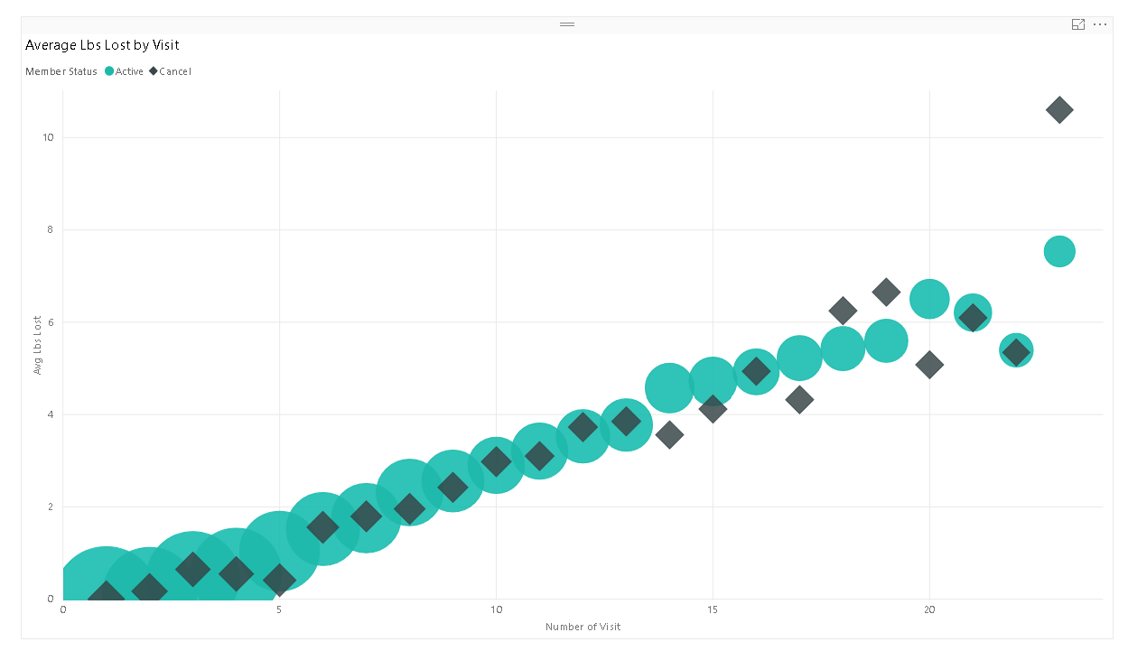
Is there a relationship between number of visits and lbs. lost?

Slide 12
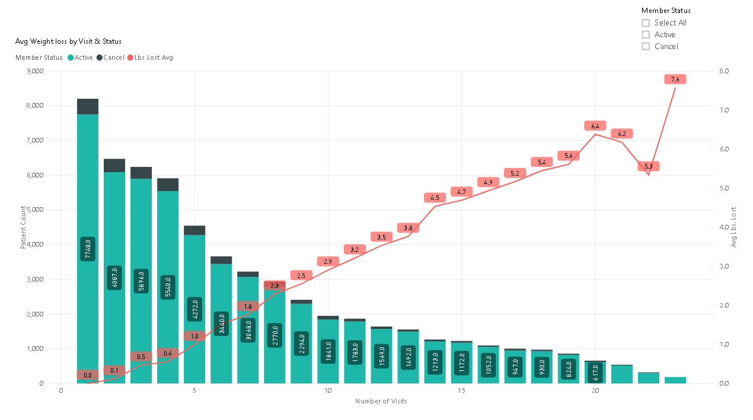
Is there a relationship between number of visits and member status?

Slide 13
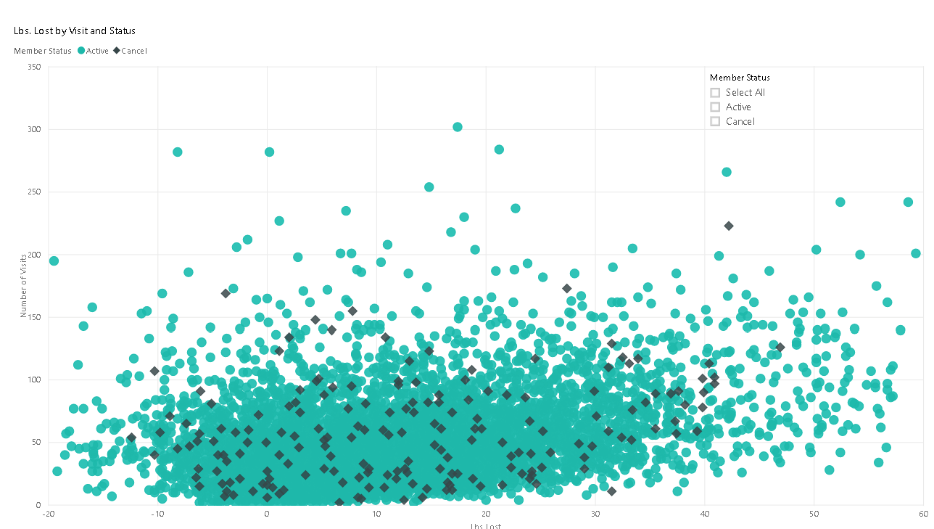
Is there a relationship between weight loss and member status?

Slide 14
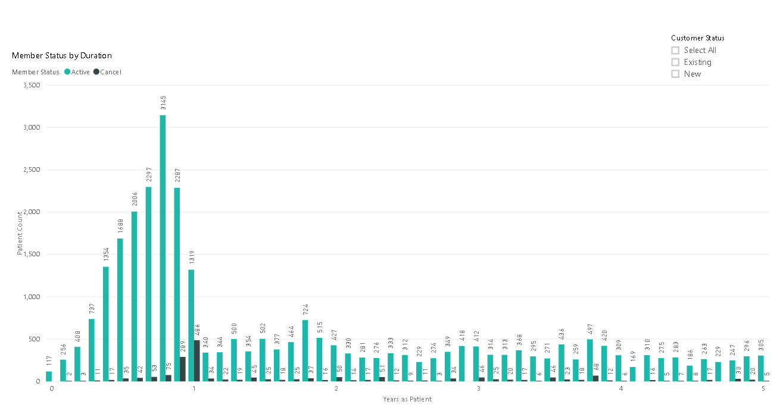
Does a relationship exist between duration of patient relationship to company and member status?

Slide 15
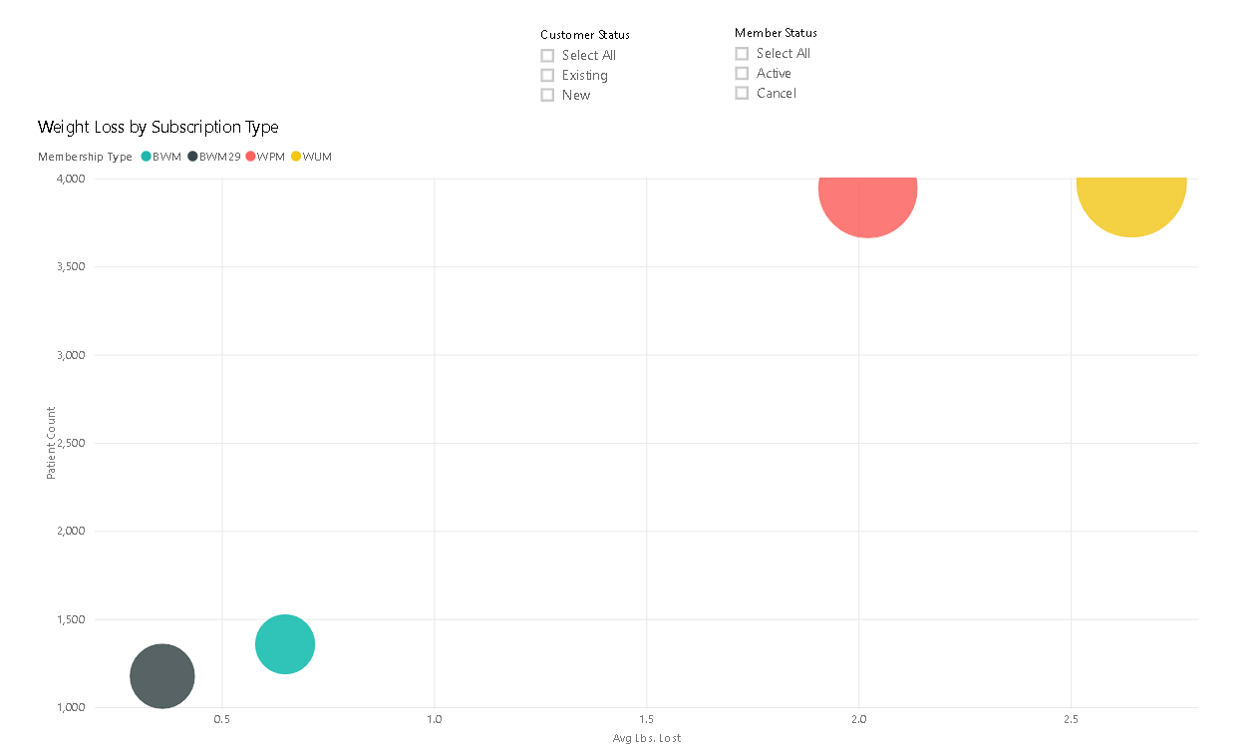
Is there a relationship between subscription type and weight loss?

Slide 16
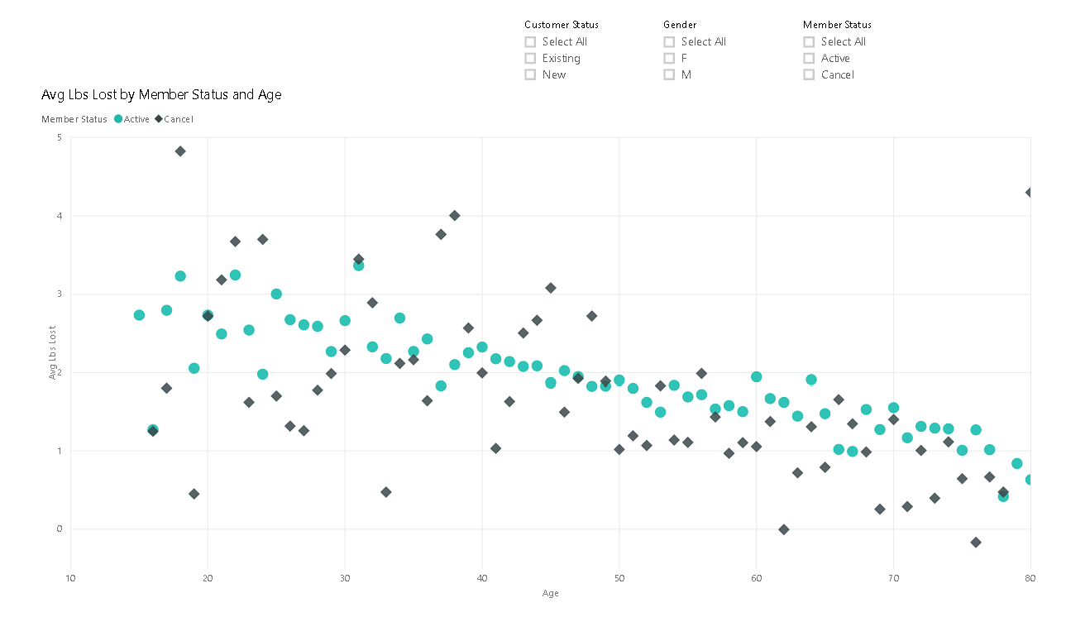
Is there a relationship Avg Lbs. Lost and Member Status by Age?

Slide 17
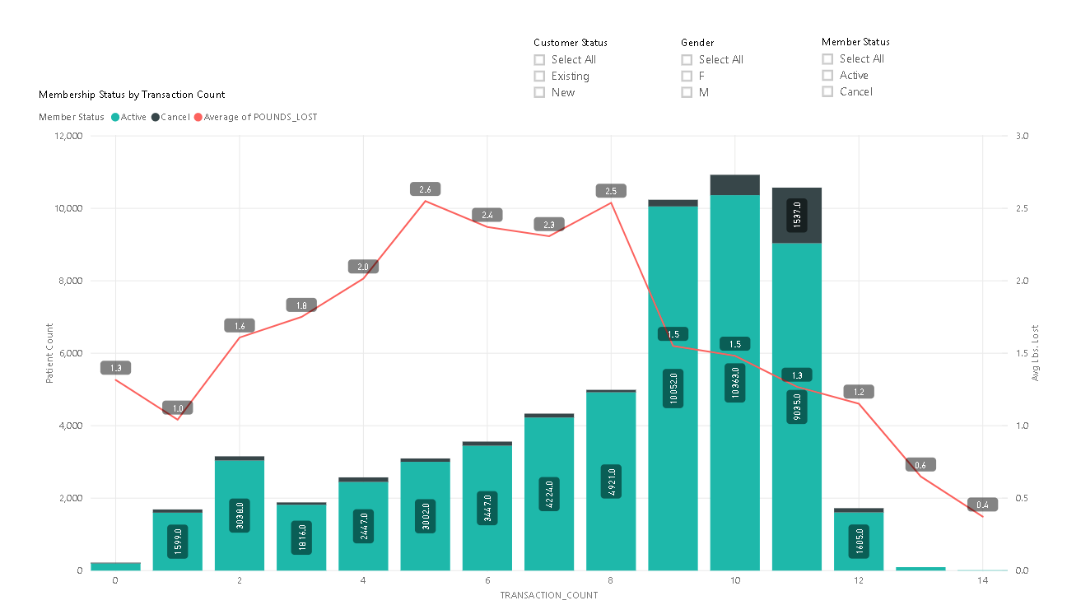
Is there a relationship between payment history and membership status?

Slide 18
Which factors are the best indicators of patient cancellation?

Slide 19
The “Unknown” Factors
How important are the visit interactions between patient and nurse in determining weight loss and number of visits.
Does the subscription model provide the outcomes and patient satisfaction that provide revenue?
How do operational policies impact patient satisfaction for maintaining a subscription model?
Is a one year subscription a viable term for membership?

Slide 20
Conclusion
In order to improve overall retention by reducing the number of cancelled subscriptions, the company should focus on:

